Slide 1
Consumer Plastic Consumption and Recycling in Marquette, Michigan
Presentation at
2024 Innovate Michigan Summit
Jelili Adebiyi, PhD
Department of Earth, Environment and Geographical Sciences
Northern Michigan University
Amelia Grabanski
Bachelor of Science: Environmental Studies, Minor: Criminal Justice
Northern Michigan University

Slide 2
Presentation Outline
Background
Findings
Conclusions
Appreciation
Data Collection
Problem Statement

Slide 3
Study Background
Upper Peninsula
Home to 3 Great Lakes - Lake Michigan, Huron, and Superior
At risk, from:
About 22 million pounds of plastics enter Great Lakes yearly
Lake Michigan: 11.6 million pounds of plastics ( 100 Olympic-size swimming pools)
Lake Huron: 1.44 metric tons of microplastic
Lake Superior: 0.02 metric tons
Massive threat to aquatic organisms and wildlife in the lakes and millions rely on the lakes for drinking water

Slide 4
Background cont’d
“Plastic pollution… is a consumption problem” - Volunteer Manager at Alliance for the Great Lakes
Consumers plastic consumption behaviors to be examined
How consumers use plastics, whether they recycle plastics, and how they manage their plastic waste
Residents’ awareness and knowledge of plastic sustainability issues

Slide 5
Problem Statement
Explore plastic consumption and recycling habits of Marquette County residents
Explore residents’ thoughts on impediments to switching from excessive plastic consumption to more sustainable materials

Slide 6
Data Collection
Using sequential mixed methods
Qualtrics-administered survey (n=129, still ongoing)
Resident of Marquette County
Assess plastic consumption, reuse, and recycling habits of respondents and knowledge of plastic consumption sustainability issues

Slide 7
Data Collection cont’d
Interviews (Upcoming): To explore:
Plastic consumption habits
Plastic recycling practices
Motivations to use less plastic and supporting residents to make the transition

Slide 8
FINDINGS

Slide 9
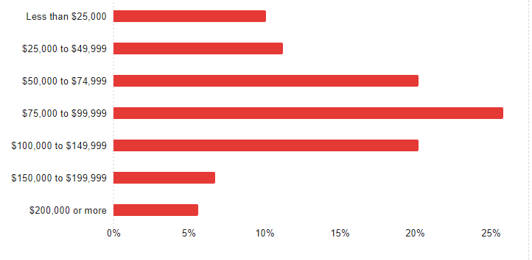
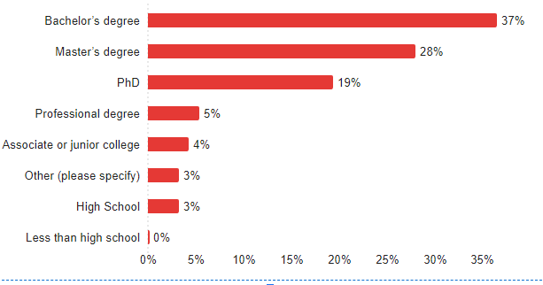
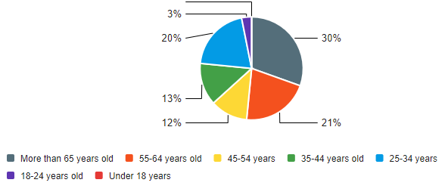
Respondents’ Demographics
Different ages, income levels, and education levels

Slide 10
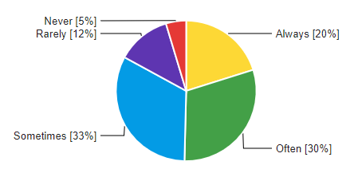
Respondents’ Attention to Quantity of Plastic in their items During Shopping
Respondents’ Major Source of Plastic Consumed

Slide 11
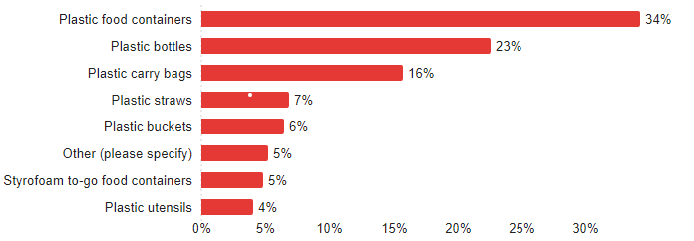
Plastic Products Often Consumed by Respondents

Slide 12
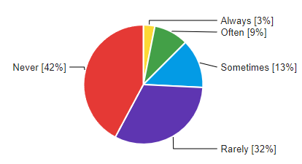
Consumption Frequency of Some Plastics by Respondents
Consumption Frequency of Plastic Takeout Containers
Con. Frequency of Disposable Plastic Straws
Consumption Frequency of Reusable Cup

Slide 13
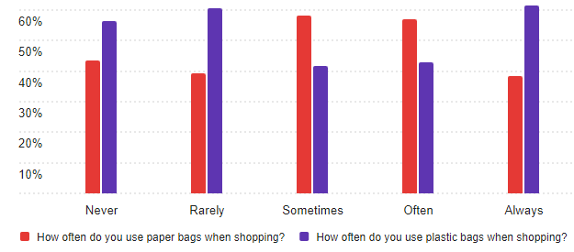
Use Frequency of Plastics and Paper Bags For Shopping

Slide 14
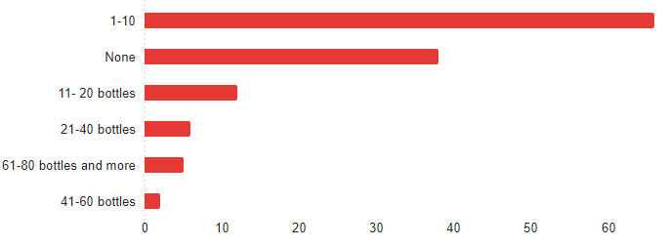
Quantity of Plastic Bottles of Water/Soda Drinks Bought & Consumed By Respondents Monthly

Slide 15
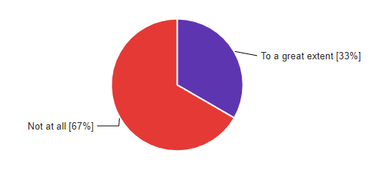
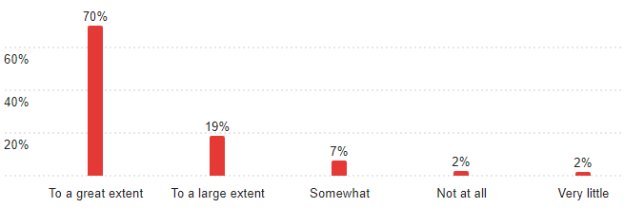
Participation in Recycling and Recycling of Plastics
Recycling of Plastics
Participation in Recycling Programs

Slide 16
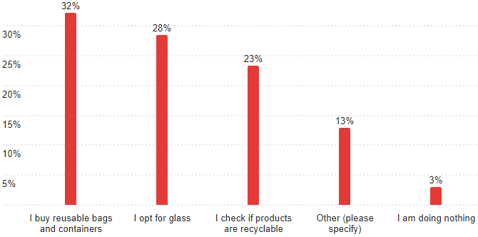
Respondents’ Plastic Reduction Actions

Slide 17
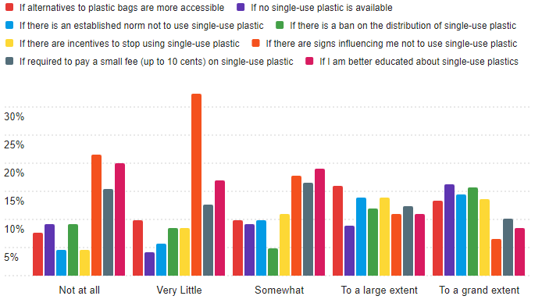
Encouraging Respondents to Reduce Plastic Consumption

Slide 18
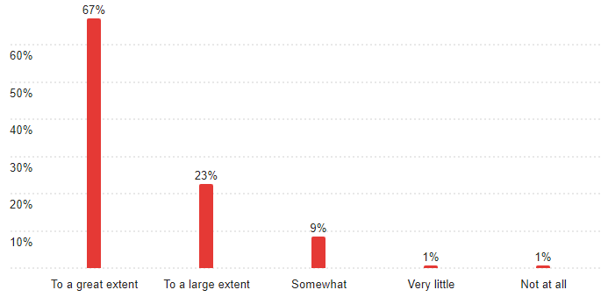
Respondents Thoughts On Switching To More Sustainable Materials

Slide 19
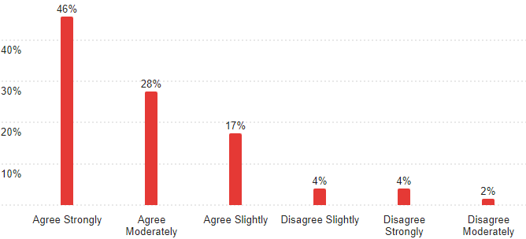
Respondents on Lack of Awareness Or Enough Education About Switching To More Sustainable Materials

Slide 20
Conclusions
Incentivize plastic use reduction and gifting by grocery stores
Consumer education on the need to pay attention to the amount of plastics in their grocery items
Education programs and publicity aimed at making consumers reduce the amount of plastic food containers, bottles, and bags that they are consuming

Slide 21
Conclusions cont’d
Educate consumers and create increased awareness about more sustainable materials they can switch to, to reduce and stop their plastic consumption
Encourage and incentivize consumers to take actions that will help reduce their plastic consumption

Slide 22
Food Waste Reduction at Northern Michigan University
Co-constructing Circular Economic Opportunities through University Waste to Organics Diversion Program
Presentation at
2024 Innovate Michigan Summit
Jelili Adebiyi, PhD
Department of Earth, Environment and Geographical Sciences, Northern Michigan University
Isabel Oertel
Environmental Studies and Sustainability, Biology (minor)
Northern Michigan University

Slide 23
Presentation Outline
Introduction
Methods
Results
Implications
Conclusions

Slide 24
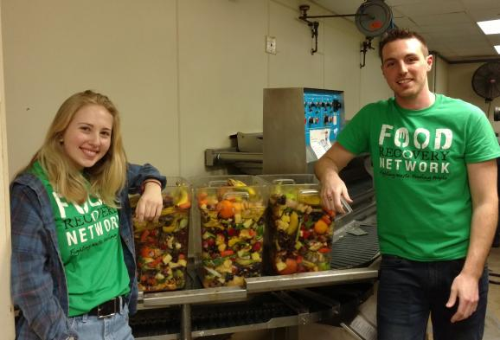
Introduction
U.S. college students generate ~110 pounds of edible food waste per student per year
Presents:
Circular opportunity for organic waste diversion for composting
Food waste reduction
Food wasted at Northern Michigan University
Knowledge gap – Reason for waste and waste reduction
Qualitatively and quantitatively explored causes of food waste at NMU restaurants to determine how to reduce it

Slide 25
Data Collection
Focus Groups:
4-8 people each
Students who lived on campus and commuting students
Reasons for food waste, waste reduction, etc.
Data-informed survey design
Survey:
Qualtrics administered
Reasons for food waste
Food waste reduction
Ongoing, but 286 responses so far

Slide 26
FINDINGS

Slide 27
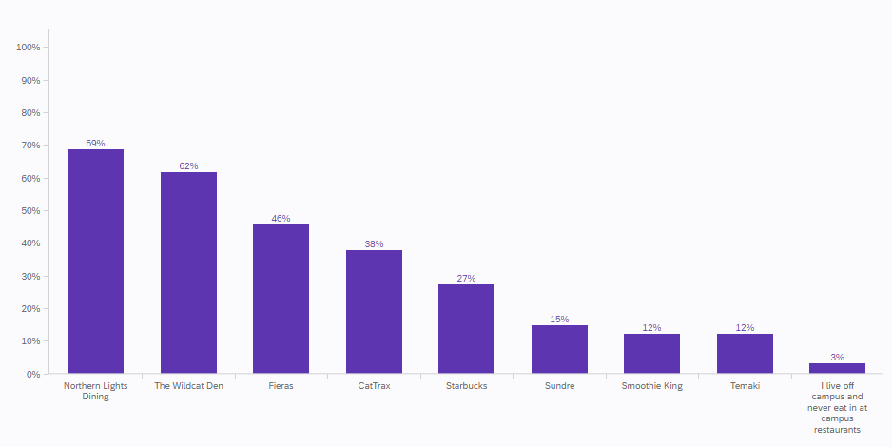
Favorite Restaurant at NMU Campus
NLD
Convenience, fast, easy
Ability to sit with friends and be social
Preference for Wildcat Den, Temaki, Fieras, Smoothie King, and Starbucks
Ability to take unfinished food to go
Perceived higher quality of the food options
Less wasting of food

Slide 28
Perception of Locations Where Students Eat Most On Campus

Slide 29
Perception of Locations Where Students Eat Most On Campus
Food Quality (NLD)
Related to pre-plated food
Quality of the food rated low, inconsistent, and repetitive
Food options not very healthy
“Whenever I used to walk in the dining hall, it was all burgers, fries, pizza – the most unhealthy food choices you could choose from except for one station–the vegan station–and I just feel like there are so many other healthy options that you can have that are so good. And we can incorporate that into our food system.”
"By the time you finish one plate, the next one is cold, and it doesn't taste as good."

Slide 30
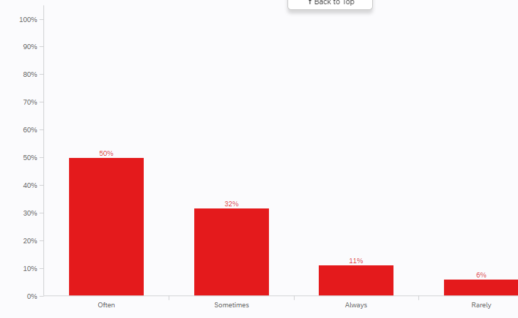
Eating Habits At NMU Facilities Other Than Northern Lights Dining
Take enough food
Majority take enough food (61%)
32% sometimes

Slide 31
Student Perception on Whether They Waste A Lot Of Food At Any NMU Dining Facility
Majority waste much food

Slide 32
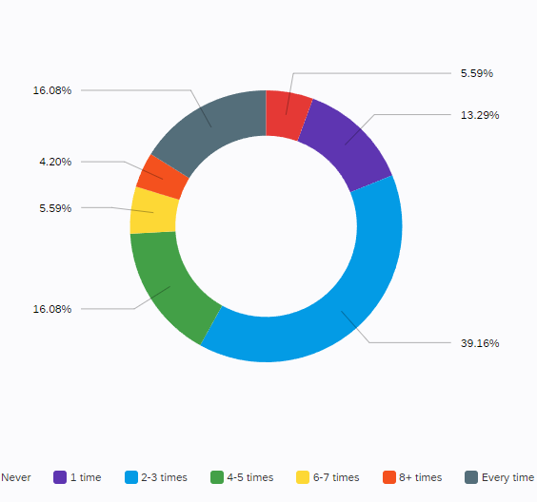
How Often Students Thrash Unfinished Food At NMU Dining Facilities

Slide 33
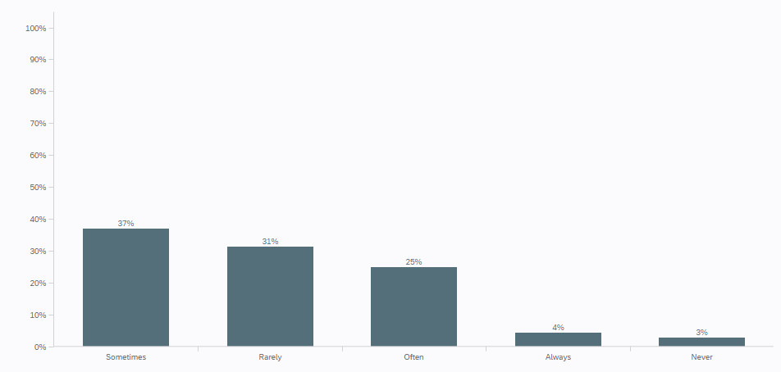
How Often Students Leave Uneaten Food When They Eat Alone At NMU Dining Facilities
NLD: Portion size and control - “You look across the dining hall, and you see people with a bowl with a bunch of food and one bite taken out of it...And then it is thrown away.” and ‘” it is weird to not be able to just pick and choose like a buffet”

Slide 34
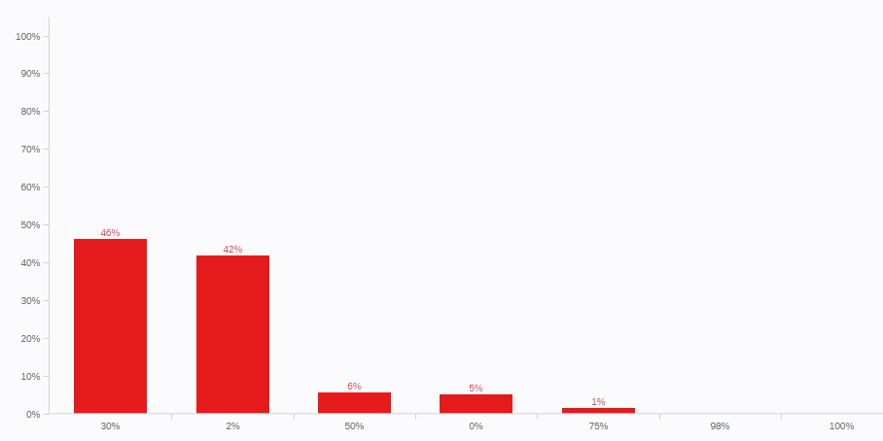
How Much Of Initial Food Usually Throw Into Trash

Slide 35
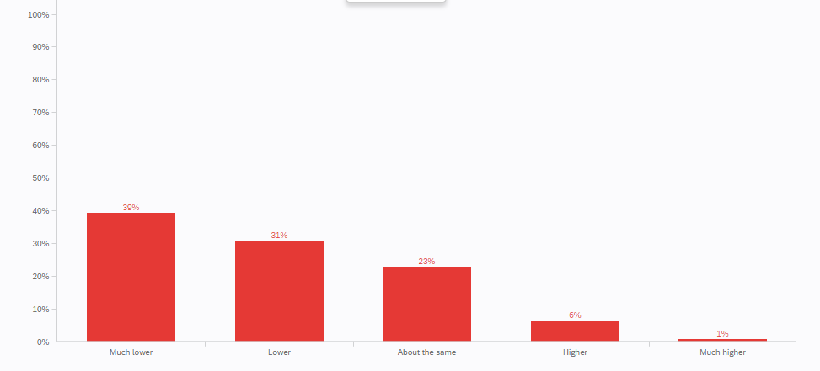
How Much Food Students Waste At Home Versus At NMU Dining Facility

Slide 36
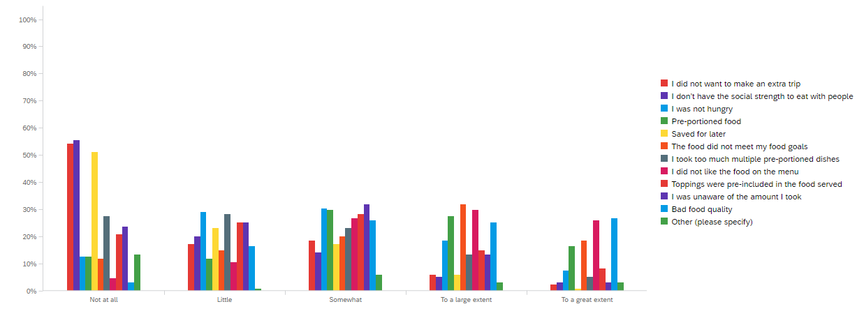
Reasons Students Do Not Finish Their Food At NMU Dining Facilities
Pre-plated foods: "If they put out, like four or five plates, that feel like awkward times in between, like lunch and dinner. They just sit there, and nobody even touches them. So, they will throw them away."

Slide 37
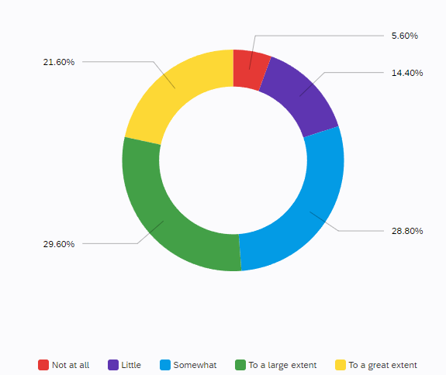
Awareness of NMU Dining Food Waste Diversion For Composting

Slide 38
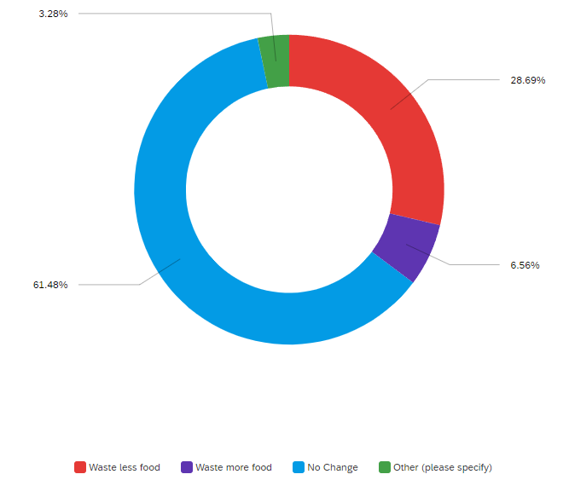
Whether Lack of Food Waste Diversion For Composting Affects Food-wasting Behavior

Slide 39
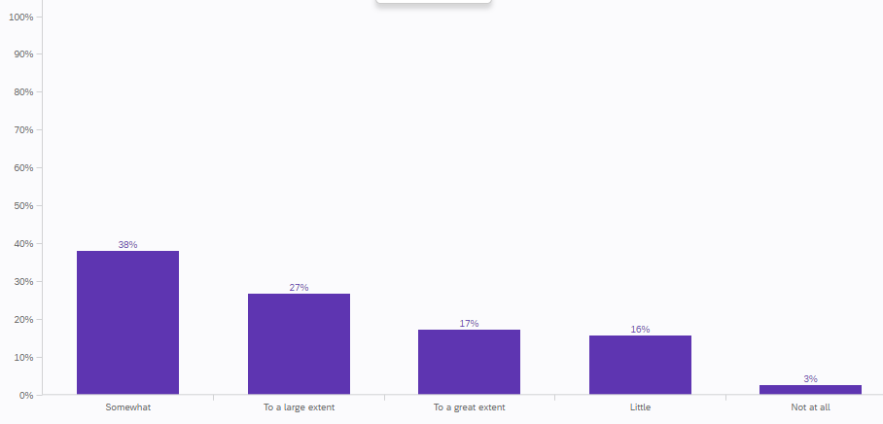
Whether Making Changes To Menu Planning Can Reduce Food Waste at NLD
Easier to overconsume and waste more
Students want to get their money's worth- “if I waste food, so what.”
Mindset ascribed to:
How much a meal plan costs
Wanting to get the most out of their plans

Slide 40
Whether Changing Service Methods Can Reduce Food Waste at NLD

Slide 41
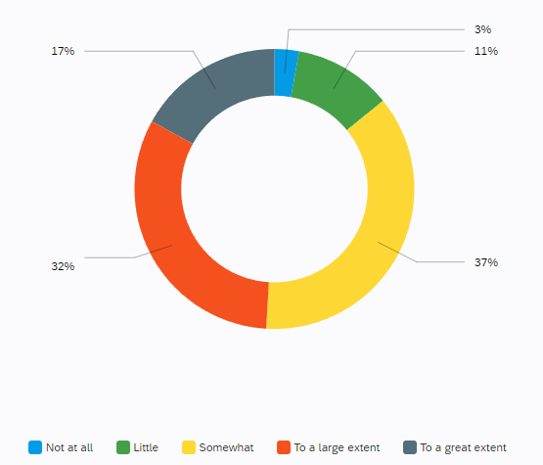
Educating Students to Reduce Food Waste

Slide 42
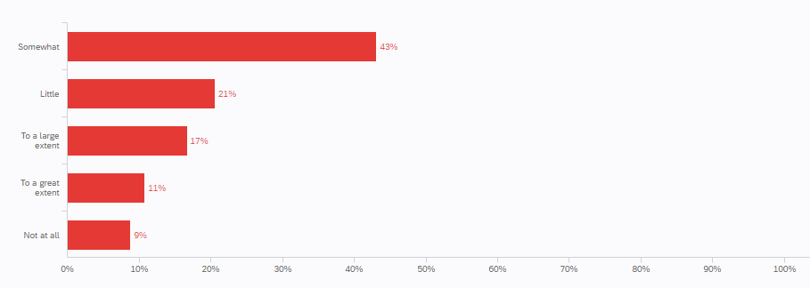
Not Pre-including Toppings to Reduce Food Waste

Slide 43
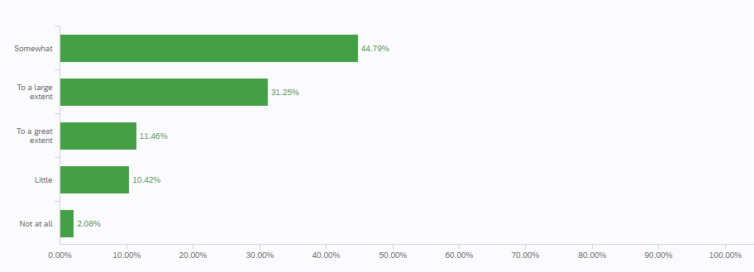
Changing To Prepare-As-Needed Topping Preparation to Reduce Food Waste

Slide 44
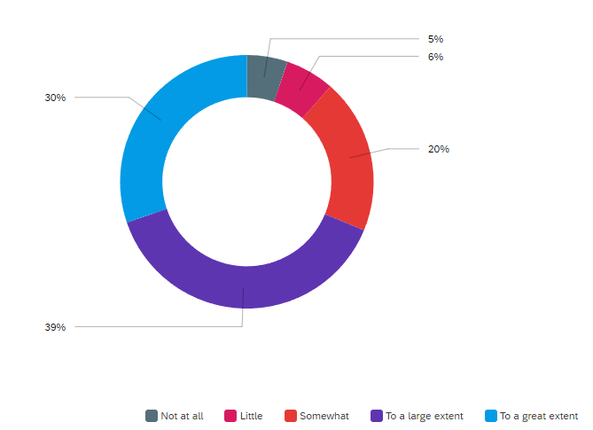
Implementing Reusable Containers to Reduce Food Waste

Slide 45
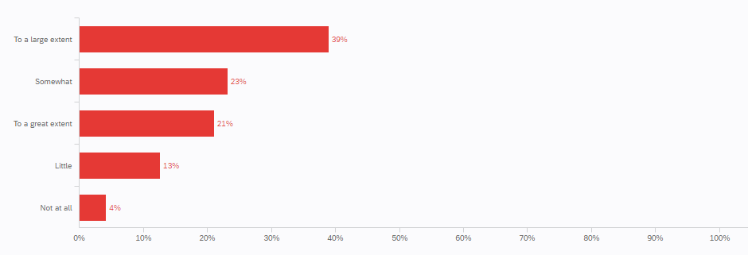
Implementing More Self-serve Stations to Reduce Food Waste
Pre-plated items:
Get cold and dry faster
Limits students to items they are familiar with
Risk of poor food quality
Portion sizes are often excessive

Slide 46
Conclusions
NMU to adopt several measures to address food waste
Food quality and variety improvements
Switch from pre-plated meals to buffet-style service
Introduce reusable container program for takeout
Integrate waste management education into the curriculum
Move away from no-carryout dining practices to more flexible and sustainable options
Food waste reduction education and integration into the curriculum

Slide 47
Thank You REI MSU for Your Funding Support

Slide 48
Thank You

